Slide 1
Design Patterns
Command

Slide 2
Design Pattern
Usage :
Common platform for developers
Best Practices
Design Pattern Classification
Creational
Structural
Behavioral

Slide 3
Command Pattern
A request is wrapped under an object as command and passed to invoker object.
Invoker object looks for the appropriate object which can handle this command and passes the command to the corresponding receiver which executes the command.

Slide 4
Command Pattern
When to use command :
A history of requests is needed
You need callback functionality
Requests need to be handled at variant times or in variant orders
The invoker should be decoupled from the object handling the invocation

Slide 5
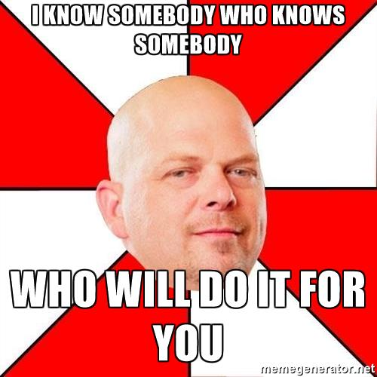

Slide 6
Structure
Client that creates a command is not the same client that executes it
Separation provides flexibility in the timing and sequencing of commands.
Materializing commands as objects
Command objects can be thought of as "tokens" that are created by one client that knows what need to be done, and passed to another client that has the resources for doing it
Notes:
means they can be passed, staged, shared, loaded in a table, and otherwise instrumented or manipulated like any other object.

Slide 7
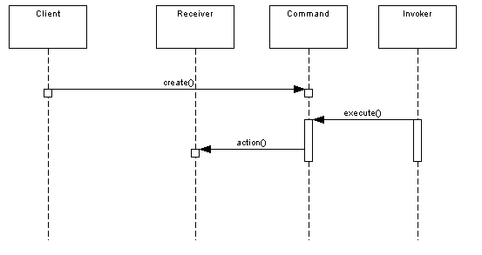

Slide 8
Check List
Define a Command interface with a method signature like execute().
Create one or more derived classes that encapsulate some subset of the following: a "receiver" object, the method to invoke, the arguments to pass.
Instantiate a Command object for each deferred execution request.
Pass the Command object from the creator (aka sender) to the invoker (aka receiver).
The invoker decides when to execute().

Slide 9
Code Sample:

Slide 10
Advantages
Command address how you can decouple senders and receivers.
Helps in logging history and undo commands.
Two important aspects of the Command pattern:
Interface separation
Time separation (stores a ready-to-go processing request that's to be stated later).

Slide 11
Drawbacks
This pattern ends up forcing extra classes
Intelligence required of which Command to use and when leads to possible maintenance issues for the central controller.
Notes:
that will make your design look cluttered

